Slide 1
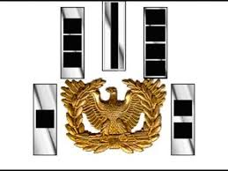
USAWOA Northeast Region (6)
50TH Annual Meeting of the Members Presentation
Aberdeen Edgewood Silver Chapter Aberdeen, MD
Arlington Hall Minuteman Silver Chapter Arlington, VA
Charter Oak Chapter Hartford, CT
Crater Chapter Fort Lee, VA
First State Chapter Smyrna, DE
Fort Dix Doughboy Chapter Joint Base McGuire-Dix-Lakehurst, NJ
Hampton Roads Chapter Fort Eustis/Hampton, VA
Keystone Silver Chapter Indiantown Gap/Annville, PA
Lord Fairfax Silver Chapter Alexandria, VA
Monocacy Chapter Fort Detrick, MD
Ocean State Chapter Quonset, RI
Patriot Chapter Fort Devans, MA
Thousand Islands Chapter Fort Drum/Watertown, NY
West Virginia Mountaineer Parkersburg, WV

Slide 2
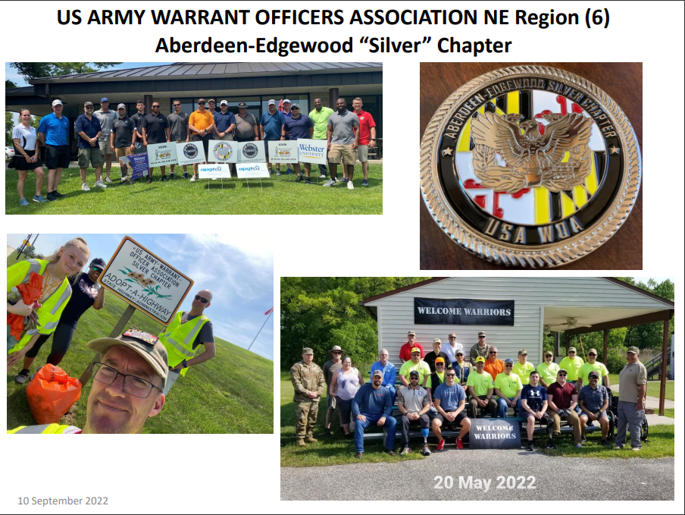
Aberdeen-Edgewood “Silver” Chapter

Slide 3
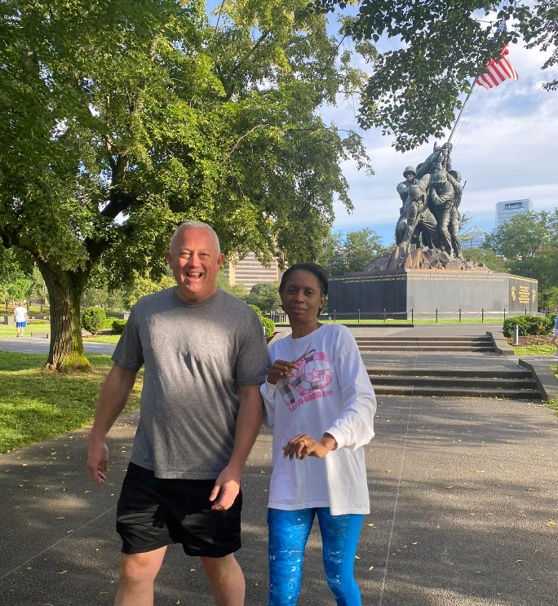
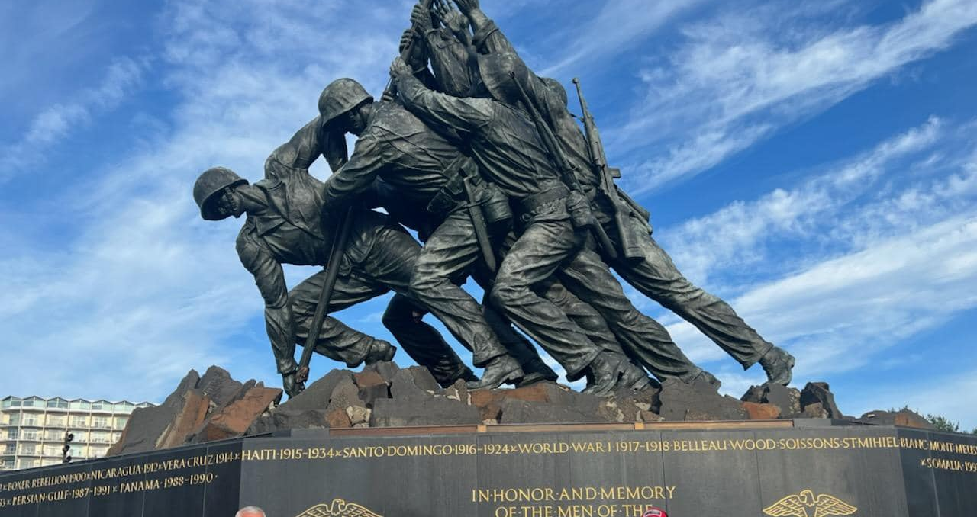
Arlington Hall Minuteman Silver Chapter

Slide 4
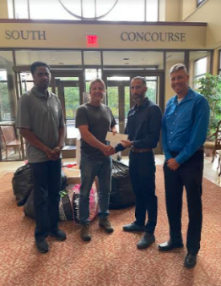
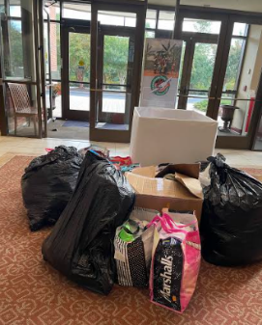
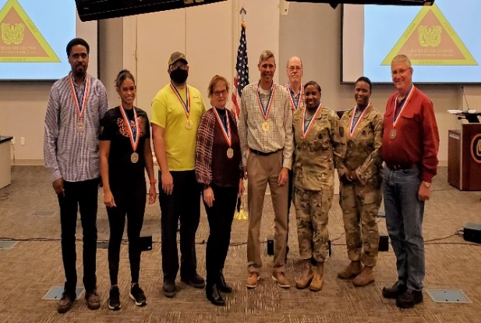
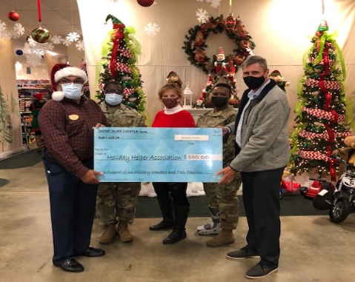
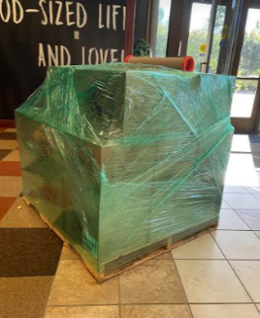
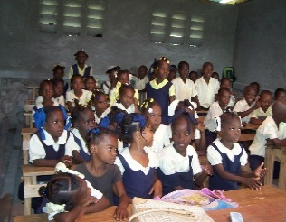
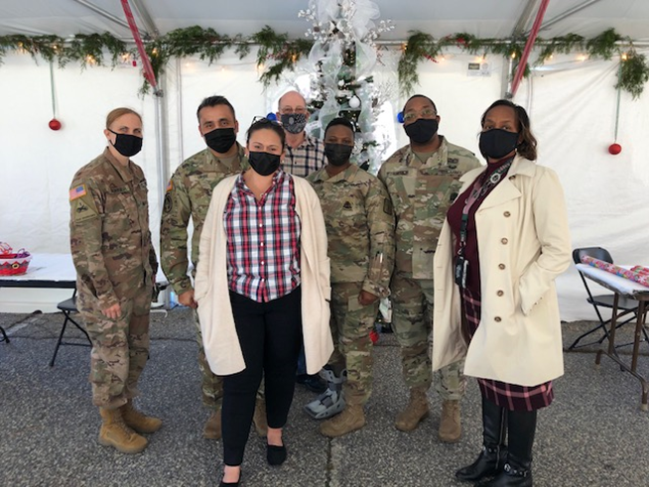
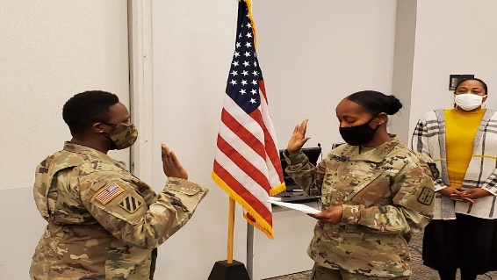
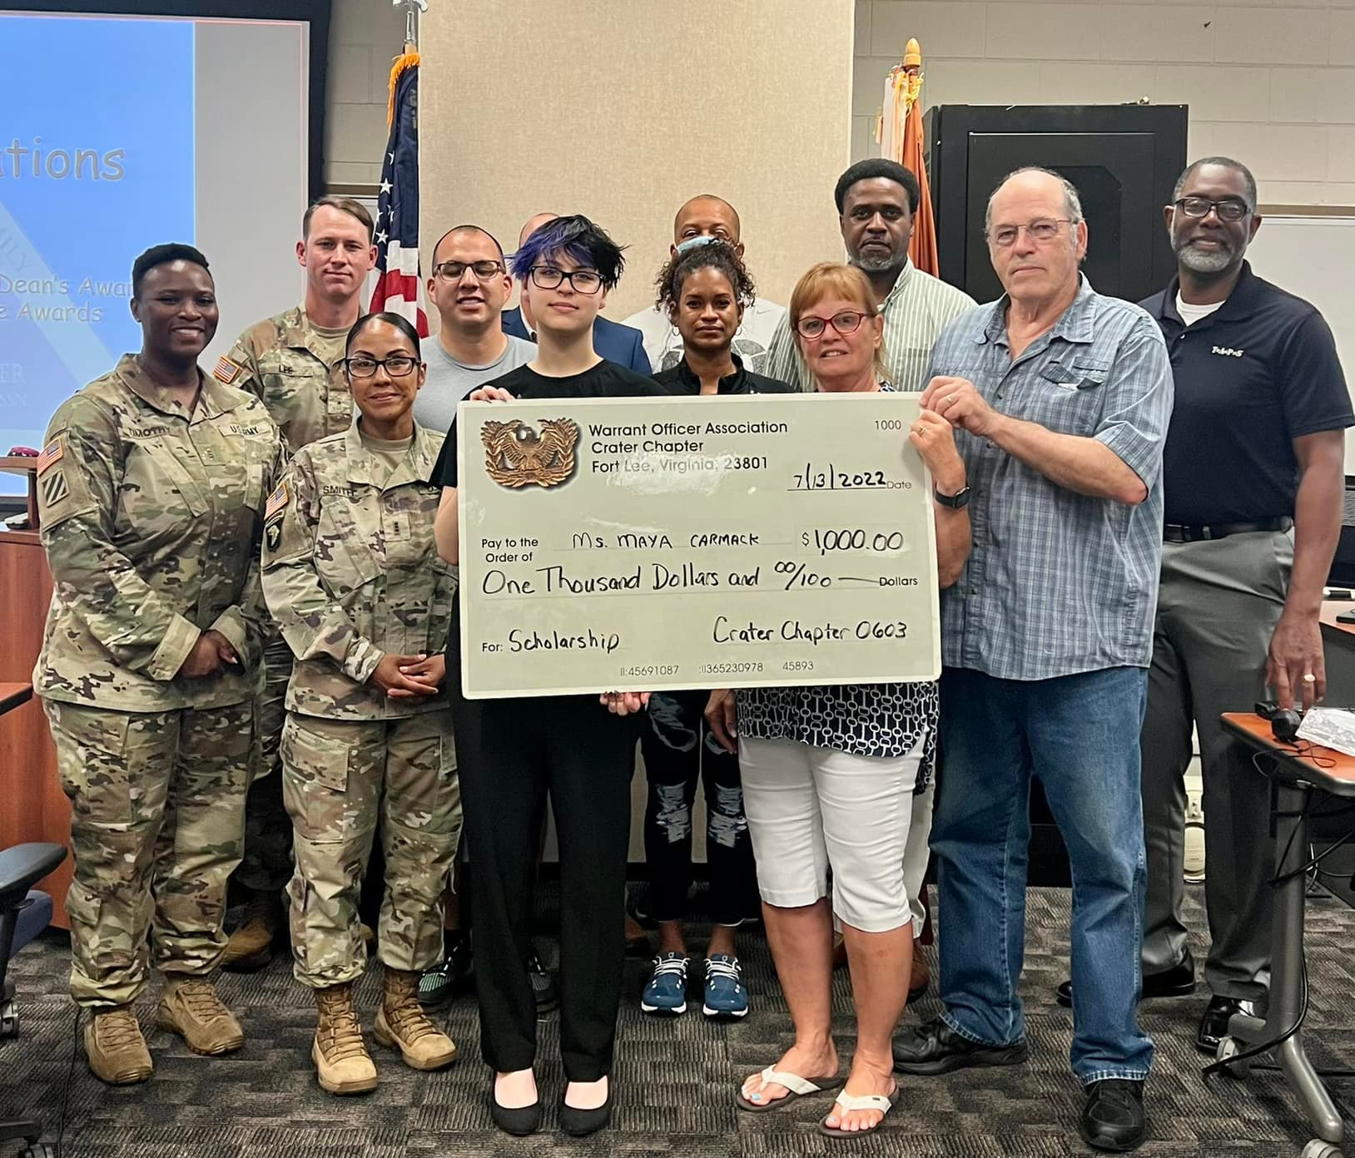
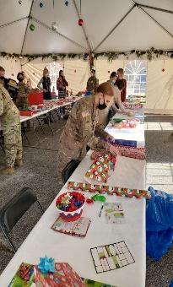
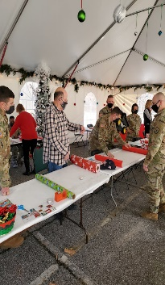
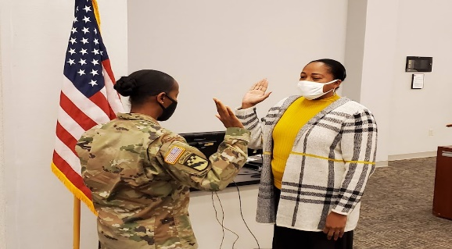
CRATER SILVER CHAPTER (0603) NE Region (6)
October 2021 – September 2022
Haiti Donation – Oct 21
2020 President Volunteer Service Awards (PVSA) – Nov 21
Wreaths Across America – Dec 21
Annual Holiday Donation – Dec 21
JROTC WOA Award Recipients – Mar 22
2021 President Volunteer Service Awards (PVSA) – Jul 22
Holiday Helper – Dec 21
President & Vice President Swears In – Jan 22
2022 Scholarship Recipient – Jul 22
Notes:
Helping Haiti Donation October 2021: Haiti has been a country that has lived in turmoil, wars, disease, and natural disasters for centuries. In 2021, Haiti experienced the assignation of their president and a 7.2 magnitude earthquake that did extensive damage to the country and, specifically to the school in the village of Fauge. to children and families throughout the village on Fauge. Crater Silver Chapter partnered with the local Heights Baptist Church supporting a ministry in Haiti called “Torch of Hope” and donated clothes, supplies, and $300 to help them rebuild the school that was severely damaged in the earthquake.
2020 President’s Volunteer Service Award: On November 2021CW5 Johnathan Waddy (Dean, Technical Logistics College/Chapter Member) led a Presidential Volunteer Service Award (PVSA) Ceremony which recognized 13 members for their remarkable individual volunteer service for the calendar year 2020. Each recipient met or exceeded the award criteria by accumulating from 100 to 1,700 individual hours and receiving either a Bronze, Silver, or Gold Level Award. BRONZE LEVEL 100 – 249 hours: CW3 (Ret) Jon Ganues (114.25 hours) not in the picture, CW5 Maria Martinez (150) not in the picture, CW4 (Ret) Charlie Mills (156.5), CW5 (Ret) Wayne Burton (156.5), COL David Buck (160 – Associate Member) not in the picture, CW4 Amy Scott (232.5), and CW3(P) Demetria Timothy (239.5). SILVER LEVEL 250 – 499 hours: CW5 (Ret) Nicole Woodyard (268.5), CW5 Travis Elliott (349), and CW5 (Ret) Vickie Vachon (397.5). GOLD LEVEL 500+ hours: CW4 (Ret) Dan Howison (549.5), CW4 (Ret) Francis Pattin (699), and CW5 (Ret) Sonia Graves-Rivers (1,700) not in the picture. Pictured left to right: CW5 Travis Elliott, CW5 (Ret) Nicole Woodyard, CW4 (Ret) Dan Howison, CW5 (Ret) Vickie Vachon, CW4 (Ret) Francis Pattin, CW4 (Ret) Charlie Mills, CW4 Amy Scott, CW3(P) Demetria Timothy, and CW5 (Ret) Charlie Mills.
ACS Annual Holiday Donation:
- ACS Annual Holiday Donation: On 24 November 2020, CW4 (Retired) Francis Pattin (Chapter President) and CW5 (Retired) Vickie Vachon (BOD Member) presented eight $25.00 gift cards to Army Community Service, Financial Readiness Program on behalf of the chapter to disperse to Soldiers in need during the Holiday Season. This is an annual event the chapter supports!
- Holiday Helper: On 14-15 December and despite the COVID19 impacts, the Crater Silver Chapter assisted the Fort Lee Holiday Helper Association to provide holiday joy to over 500 children. Chapter members contributed a total of 58 hours by picking up stocking stuffers from Dollar Tree stores leading up to the event and serving as elves to escort parents during shopping.
- Wreaths Across America: On 18 December 2021, the chapter participated in the Wreaths Across America ceremony at the City Point National Cemetery in Hopewell, Virginia. A total of 18 participants contributed over 30 community service hours.
- President and Vice President Swearing In: On 12 January 2022, CW3 (P) Demetria Timothy and CW4 (Ret) Stephanie Gaines were sworn in as President and Vice President by CW5 Belinda Jackson, Quartermaster Warrant Officer Proponent.
Scholarship Award and PVSA Recipients: On 13 July 2022, the Crater Silver Chapter’s President congratulated this year’s $1,000 scholarship award Ms. Maya Carmack, granddaughter of chapter member CW4(R) Charles “Charlie” Mills.
- President’s Volunteer Service Award November 2021Also, the chapter presented the 2021 President’s Volunteer Service Award (PVSA) to the following chapter members for their calendar year 2021 volunteer hours:
CW5(R) DAVID DICKSON - 110 hours (Bronze Level)
CW3(R) JON GANUES - 114.25 hours (Bronze Level)
CW4(R) CHARLES L. MILLS - 130 hours (Bronze Level)
CW4(R) DAN Y. HOWISON - 150.5 hours (Bronze Level)
CW4(R) FRANCIS W. PATTIN - 258 hours (Silver Level)
CW5(R) TRAVIS T. ELLIOTT - 340 hours (Silver Level)
CW5(R) VICKIE A. VACHON- 397.5 hours (Silver Level)
CW5(R) NICOLE E. WOODYARD - 621.5 hours (Gold Level)
CW3(P) DEMETRIA R. TIMOTHY - 1,117 hours (Gold Level)
CW4 AMY SCOTT - 1,141.5 hours (Gold Level)

Slide 5
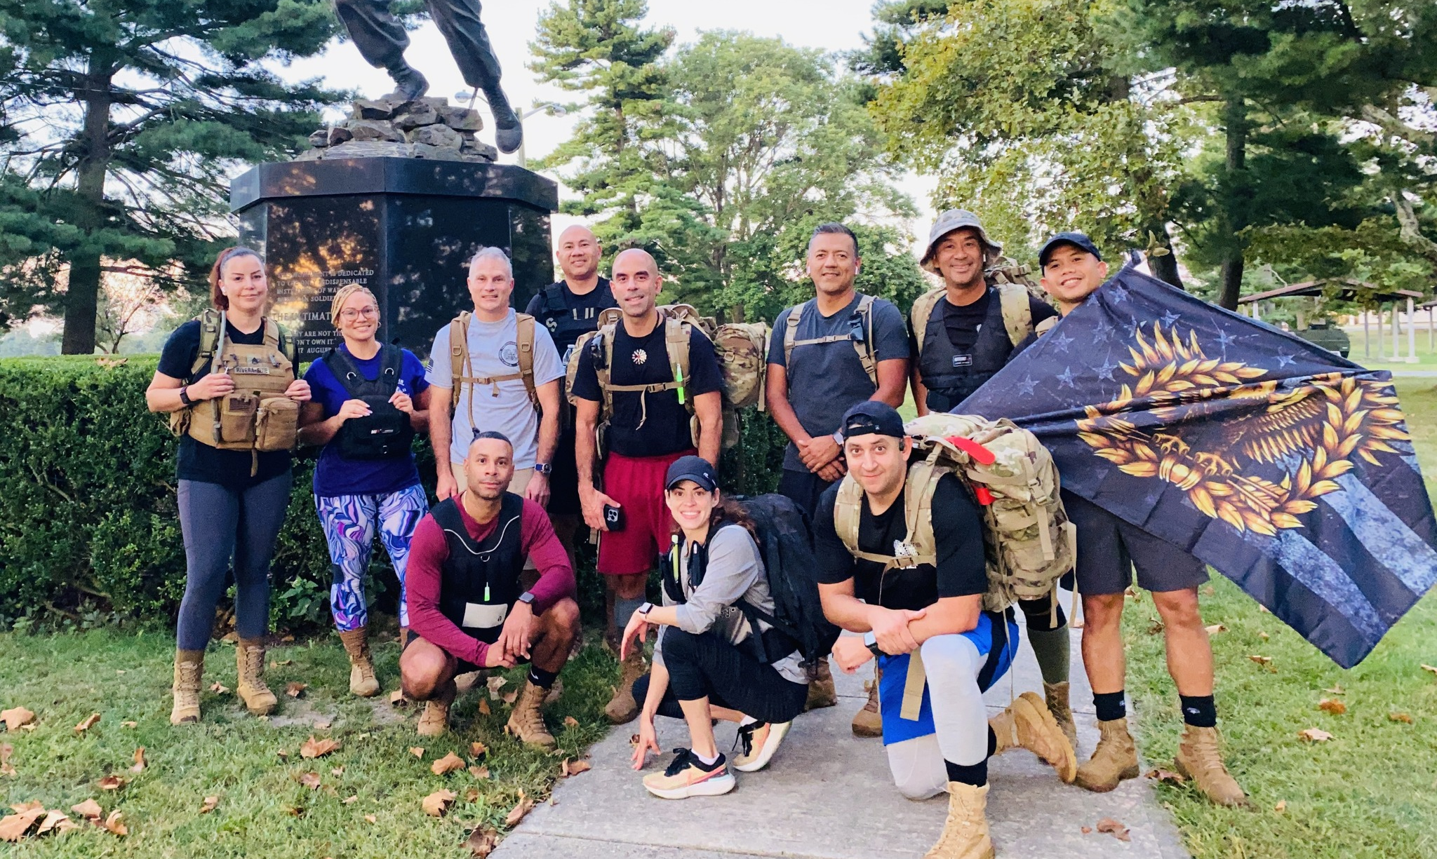
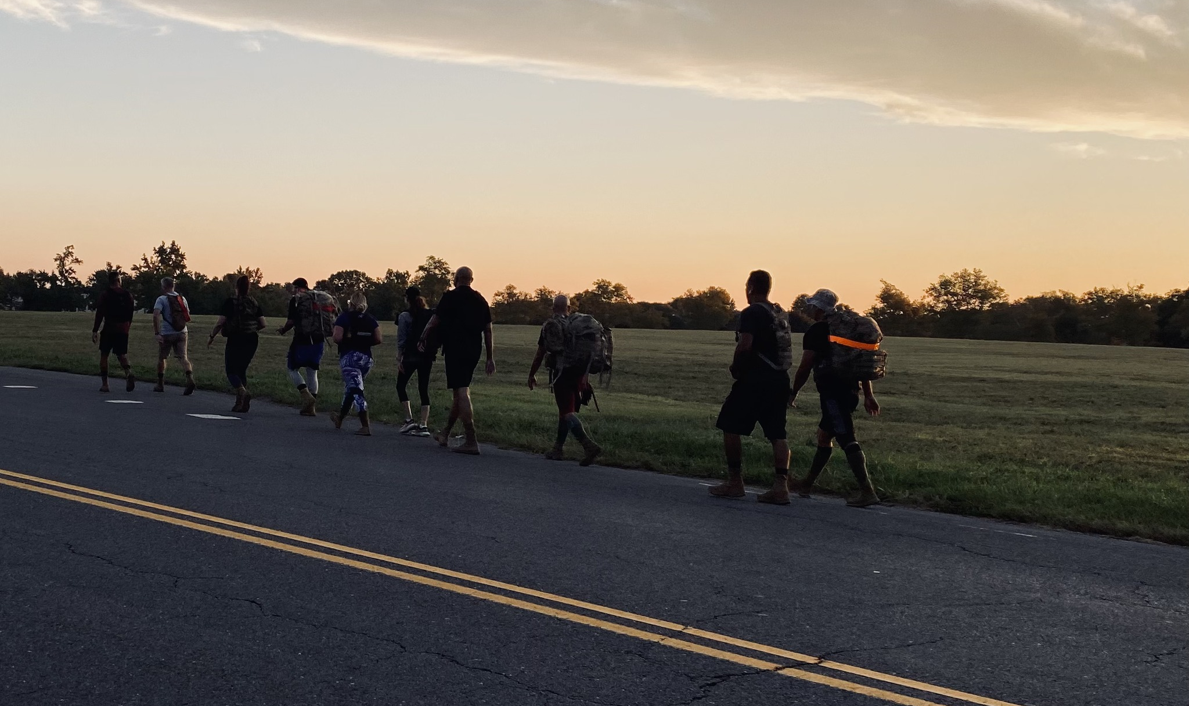
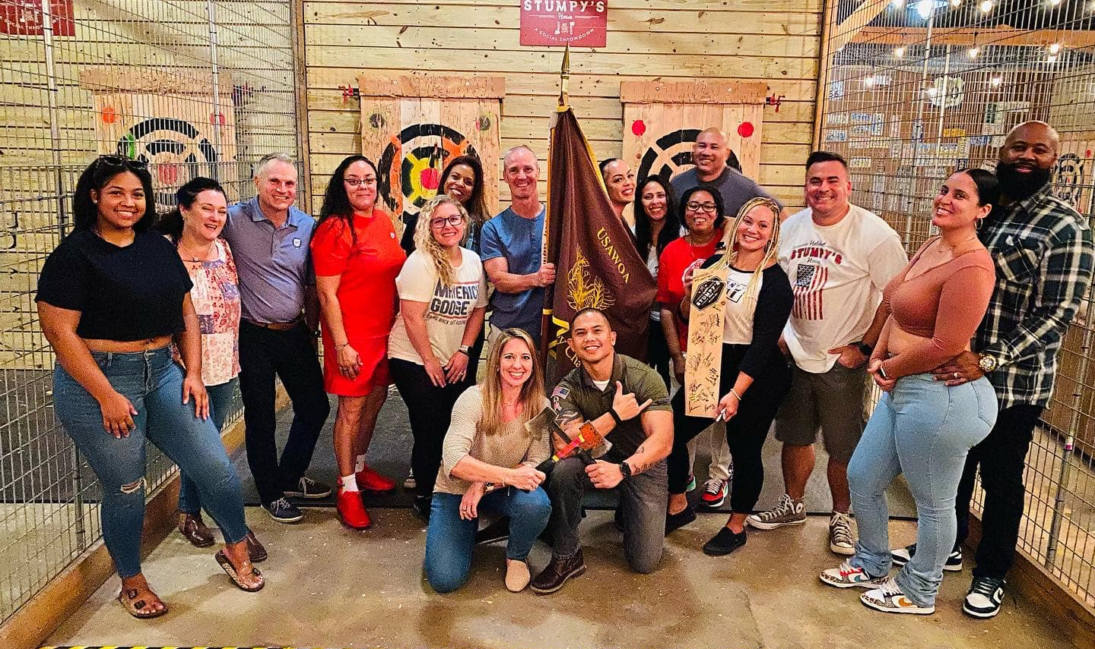
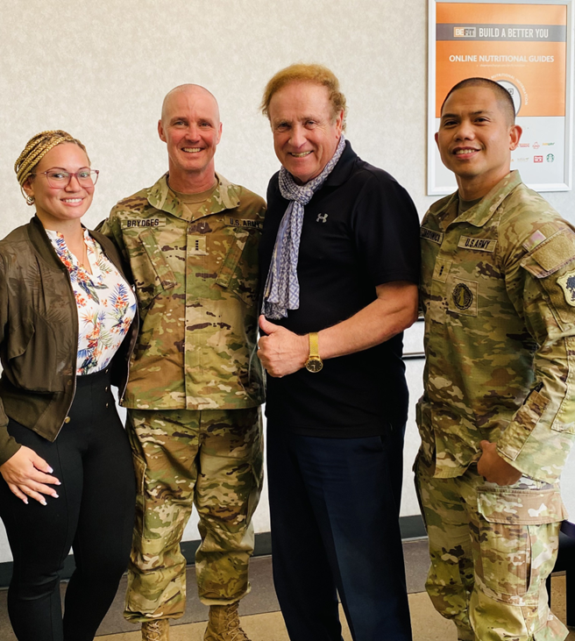
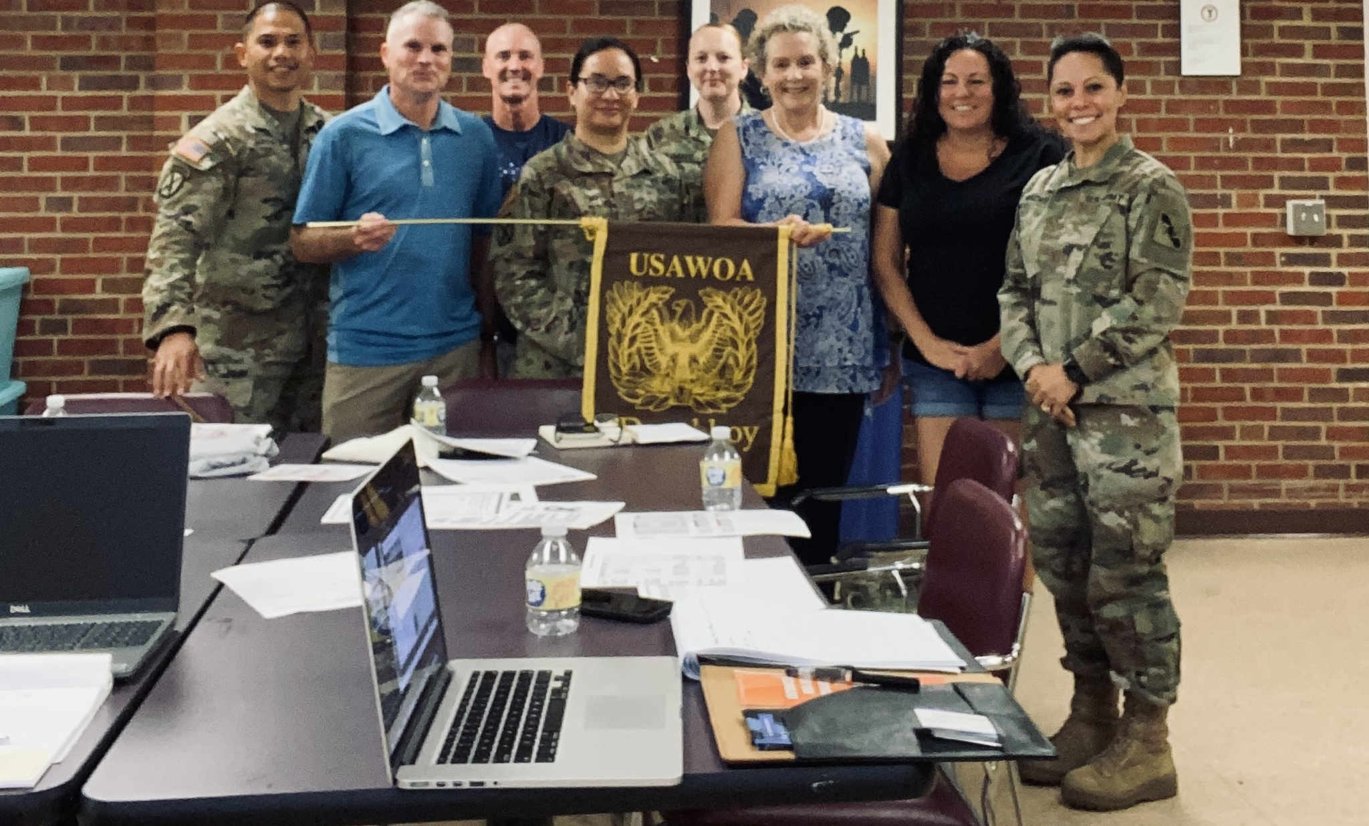
Fort Dix Doughboy Chapter

Slide 6
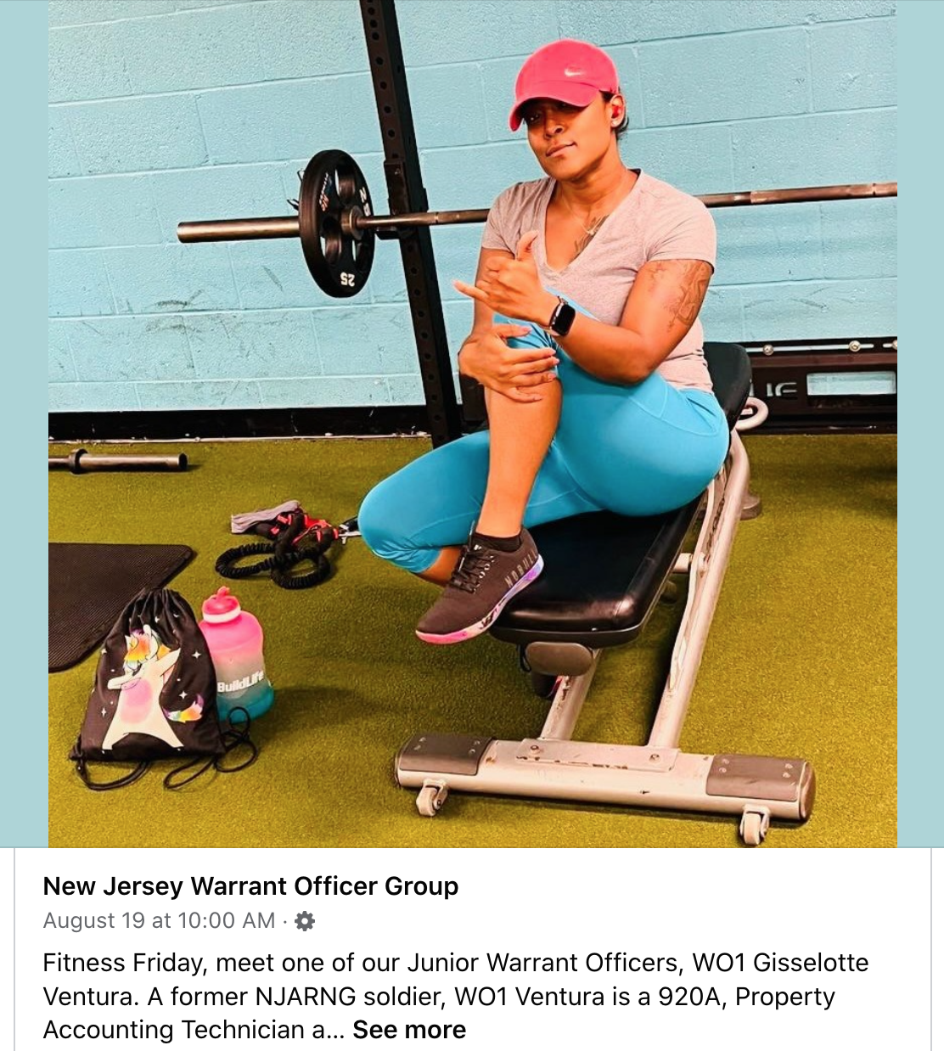
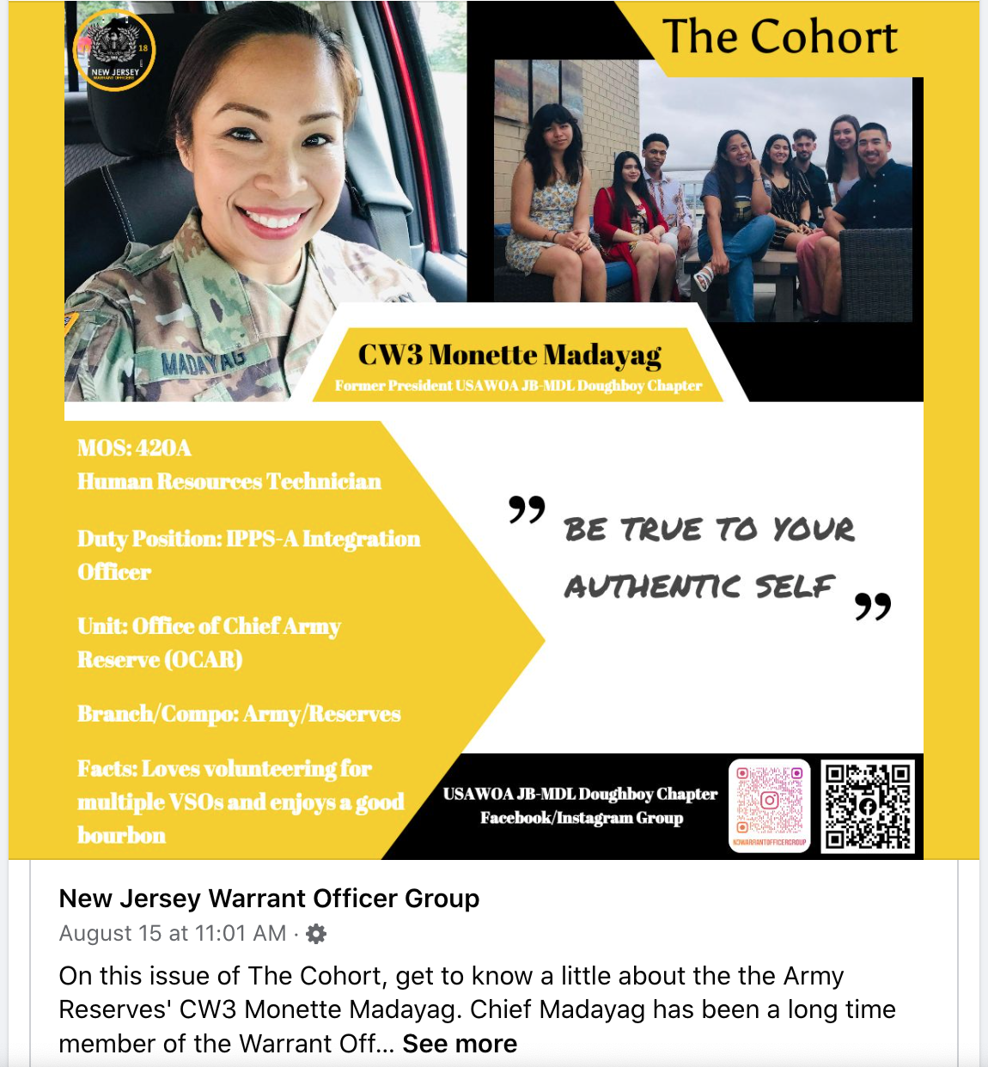
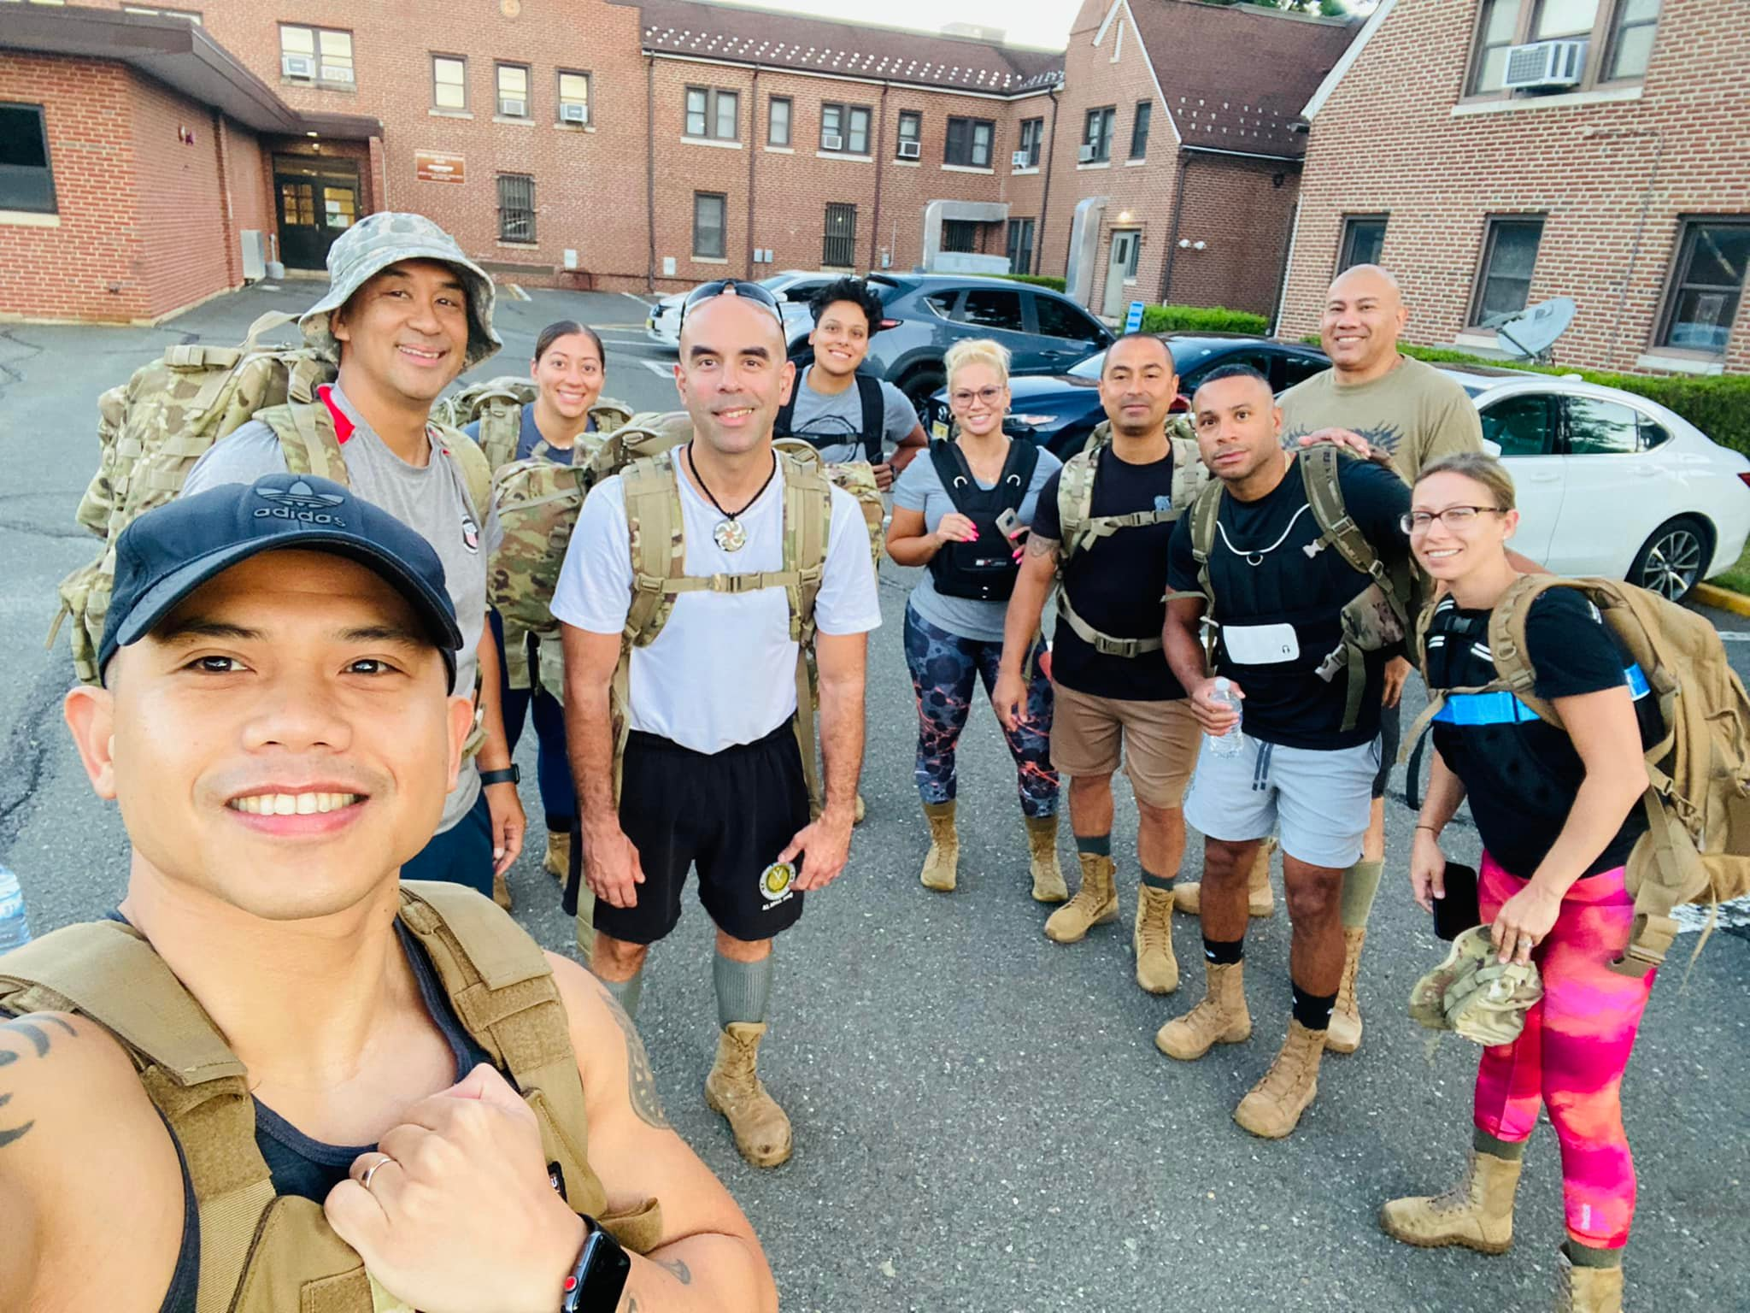
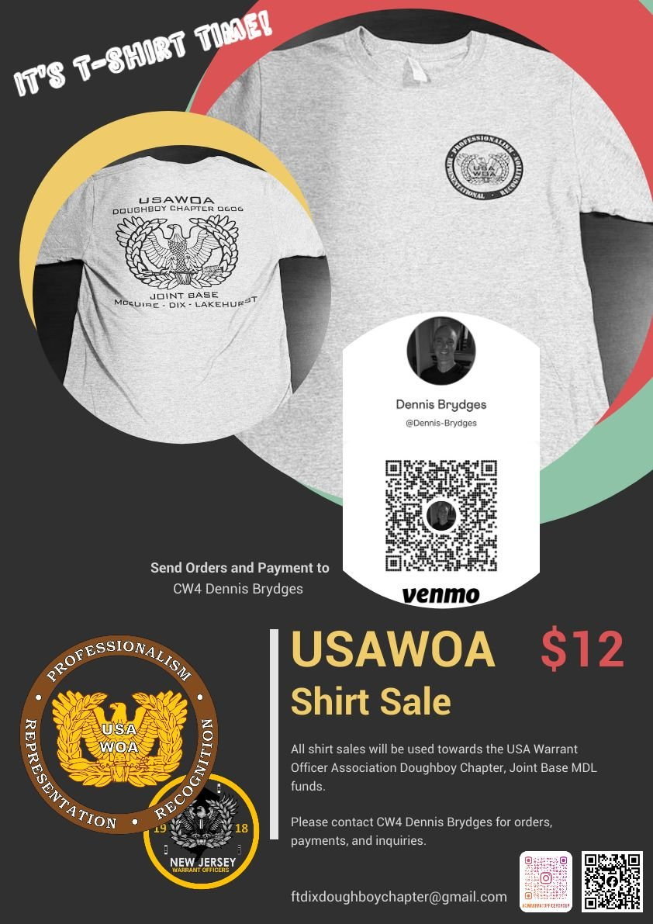
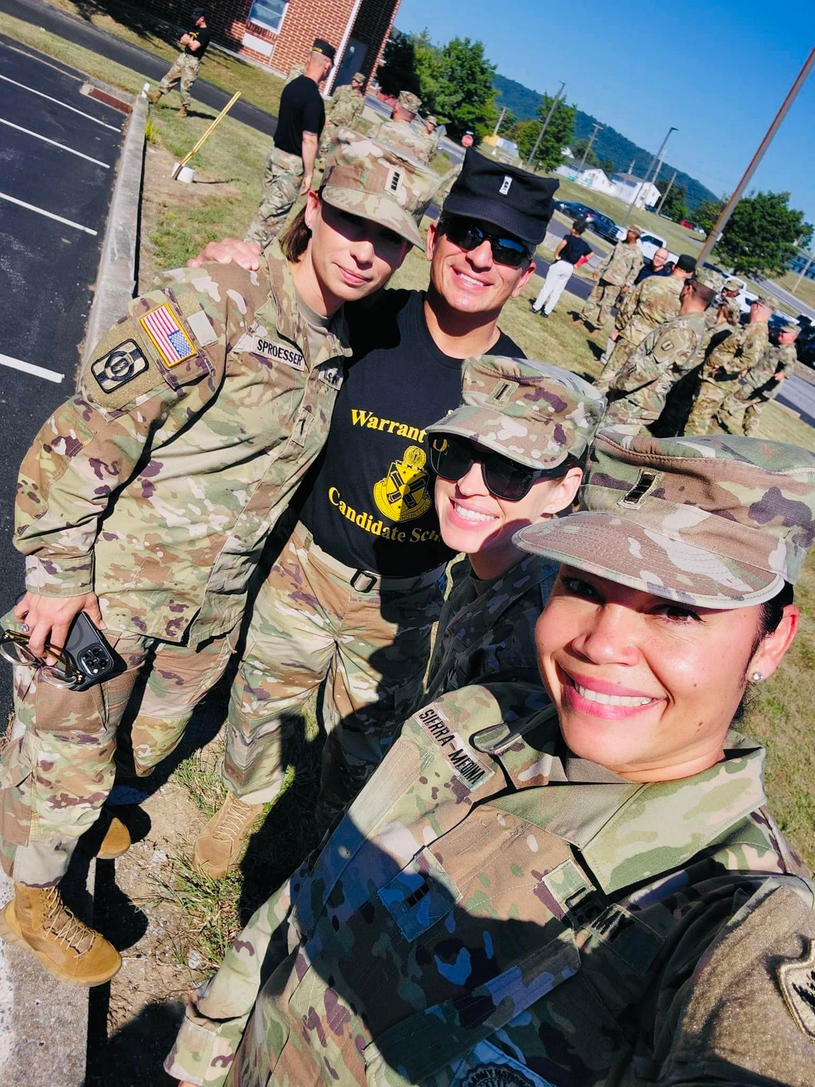
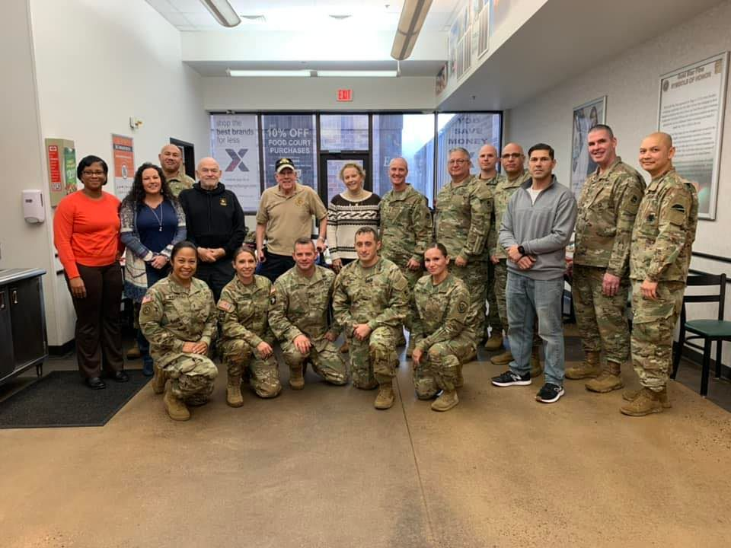
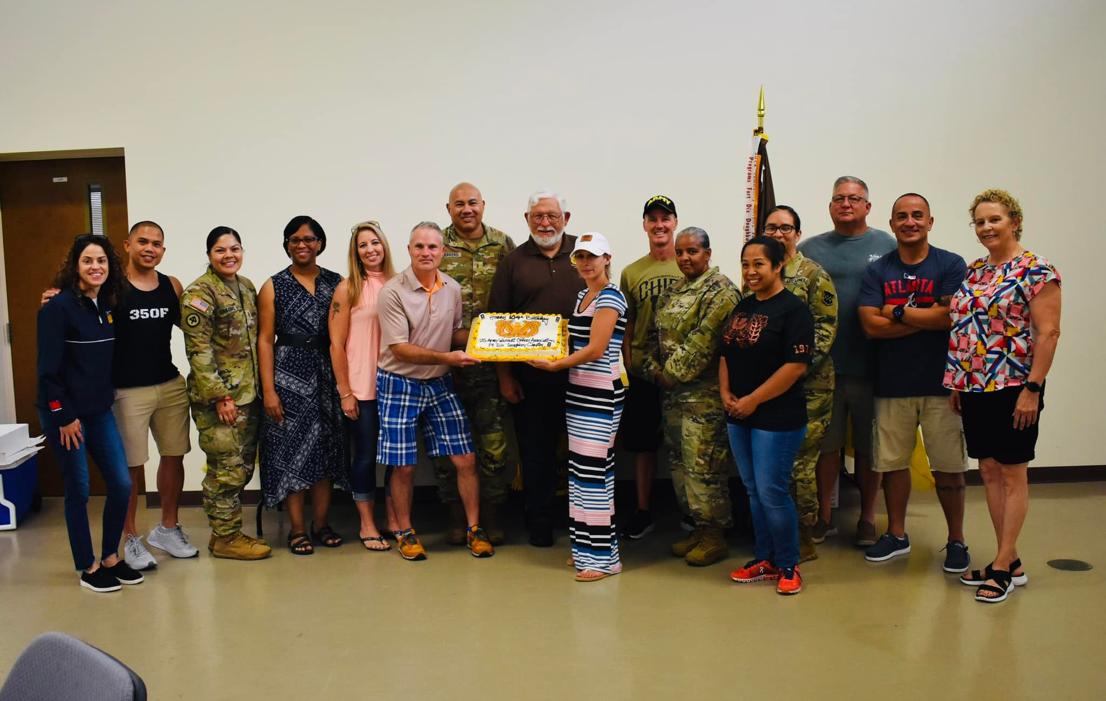
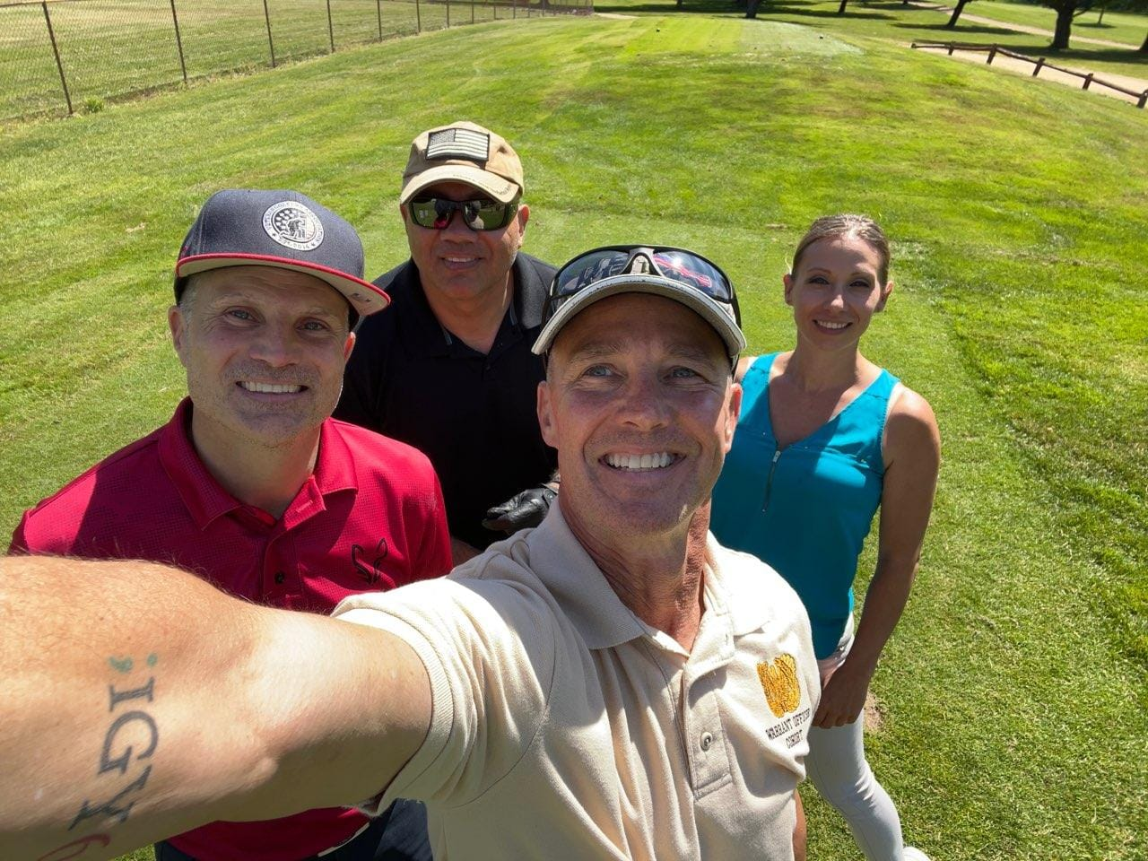
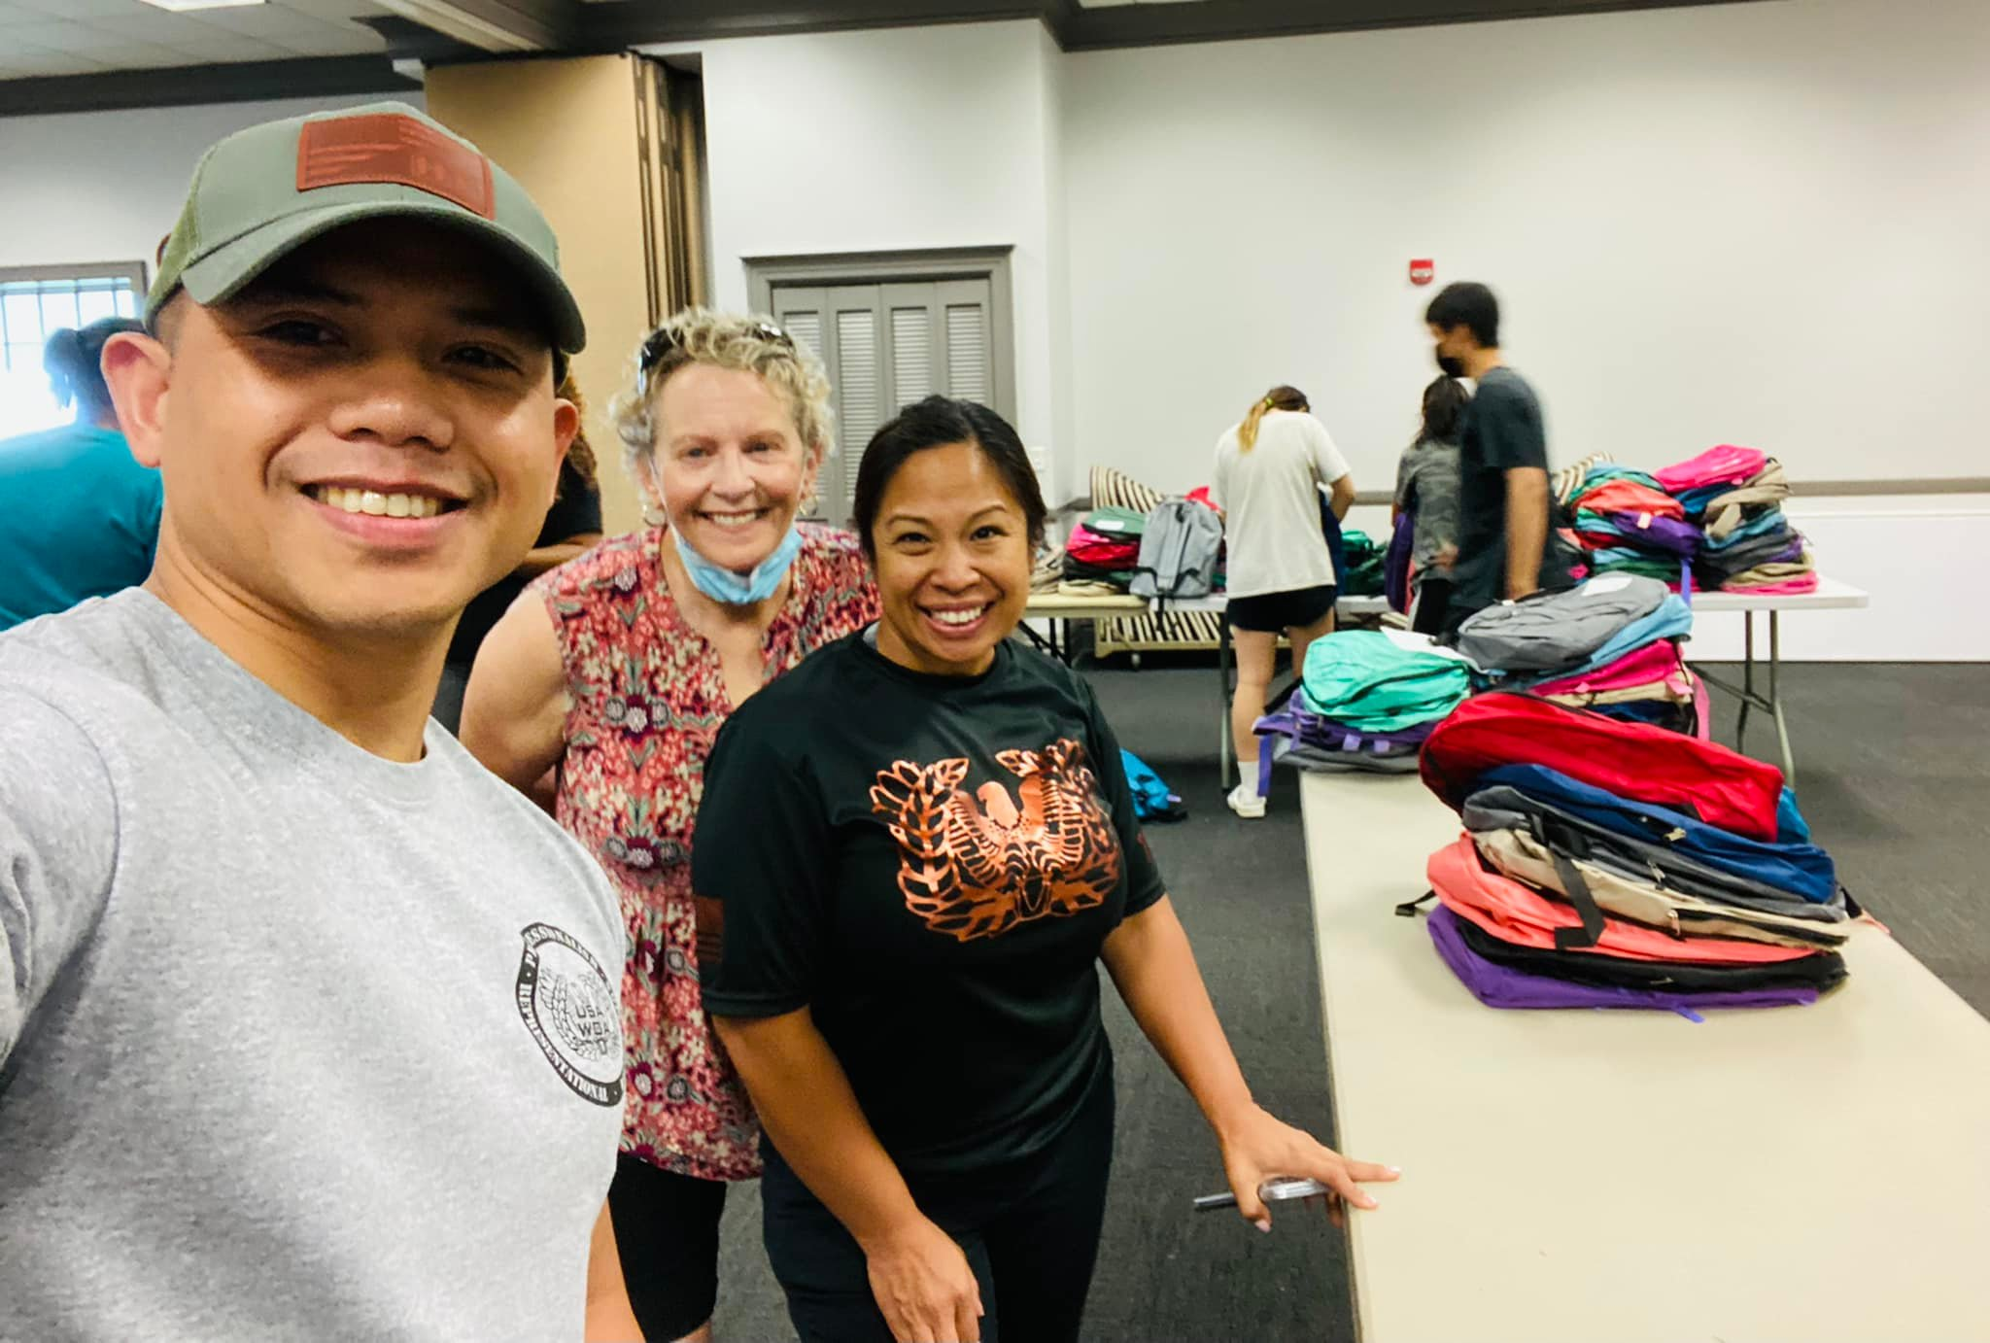
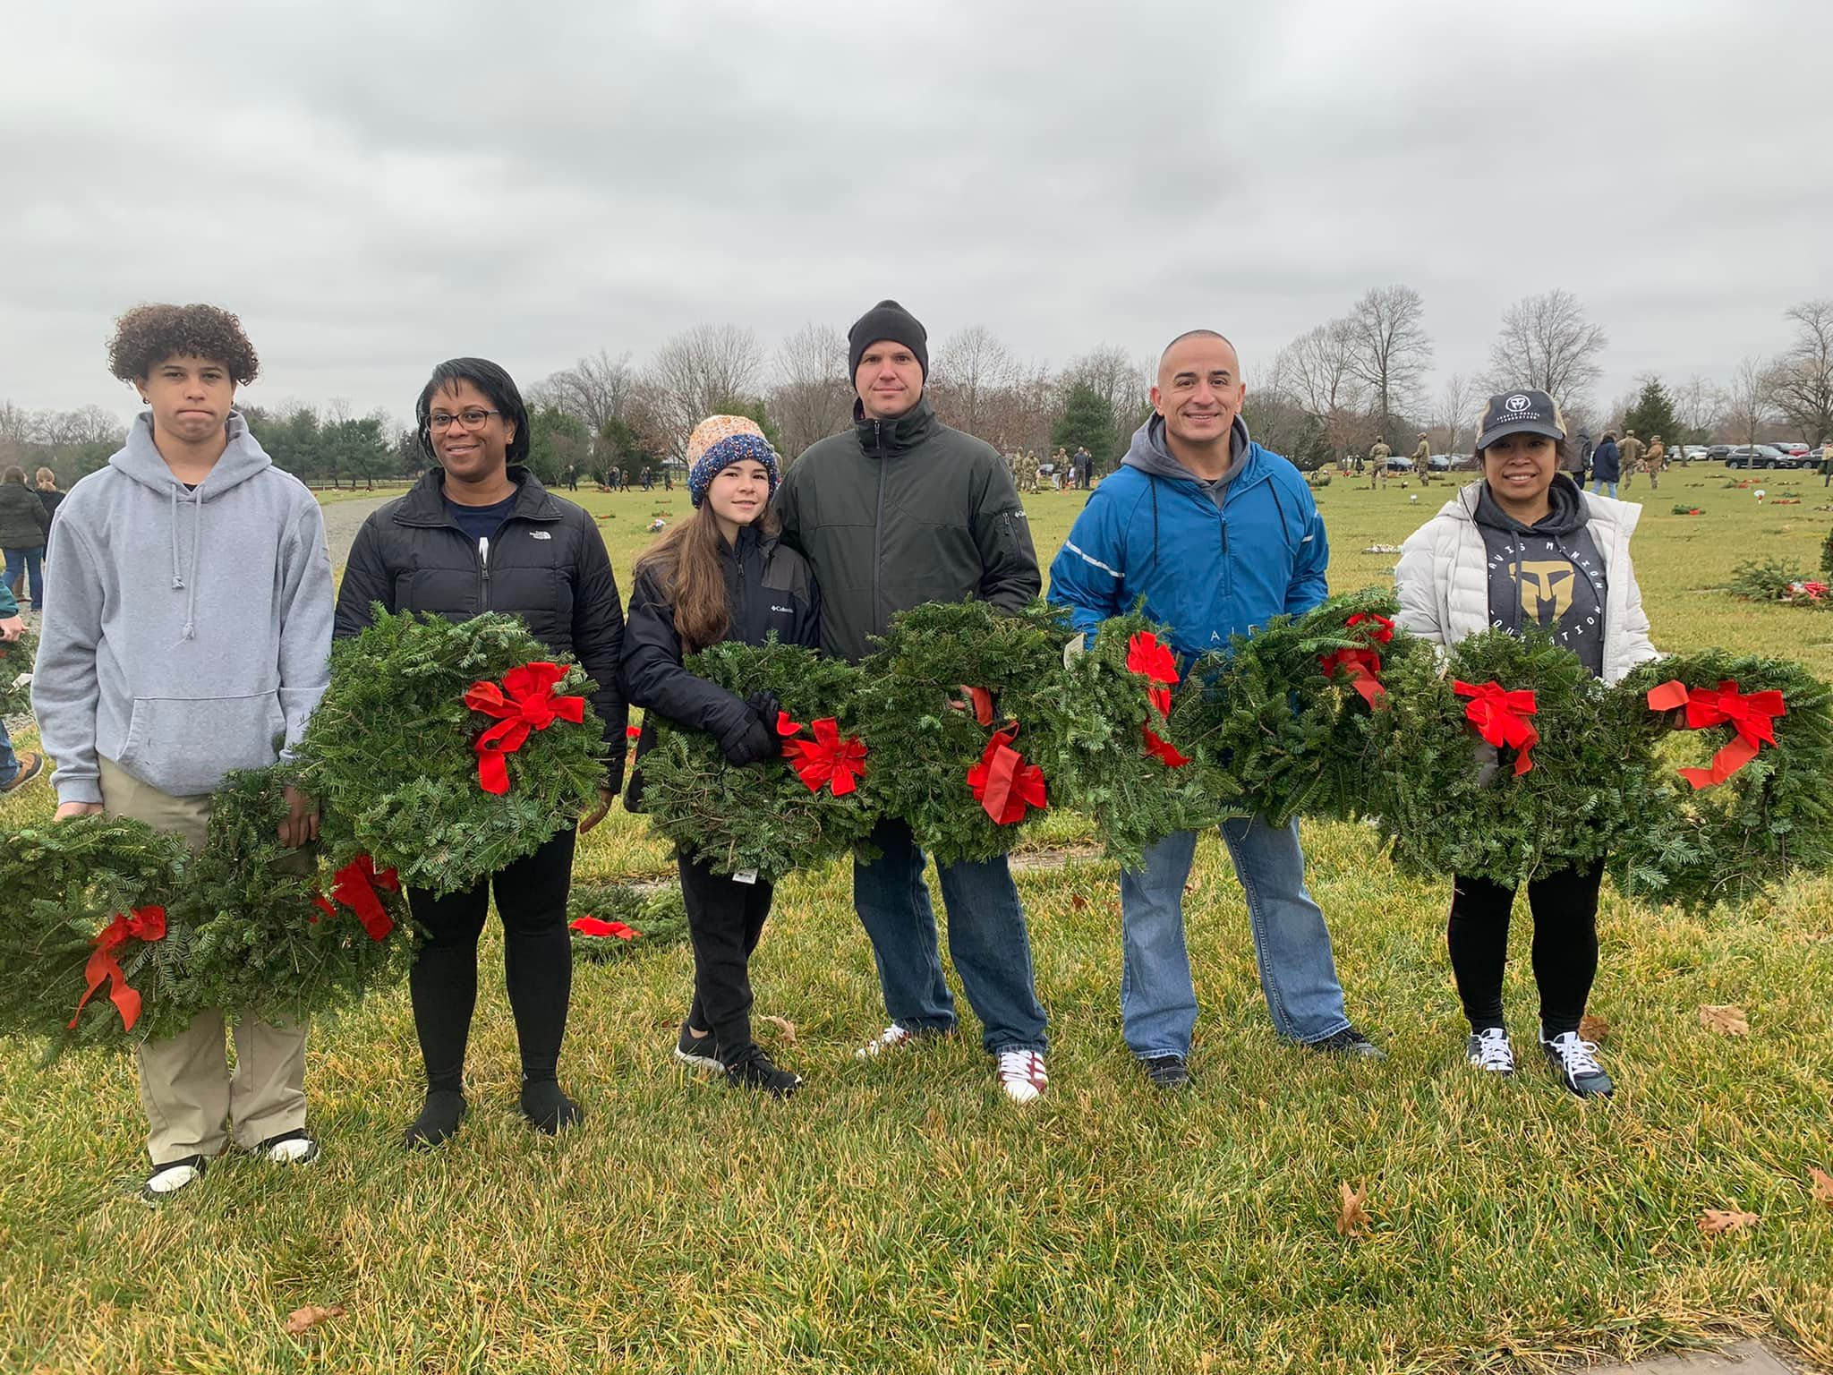
USAWOA Doughboy Chapter JB-MDL, NJ

Slide 7
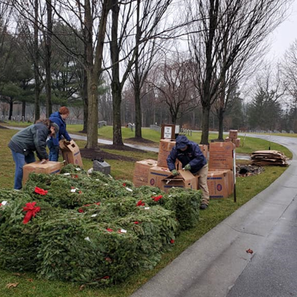
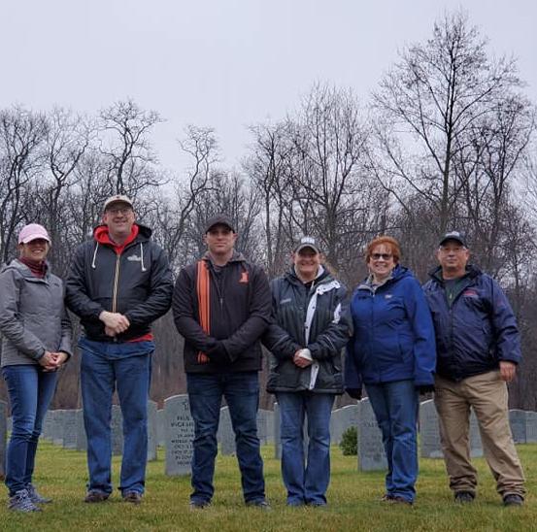
Wreaths Across America
Keystone Silver Chapter

Slide 8
Keystone Silver Chapter Paint and Sip

Slide 9
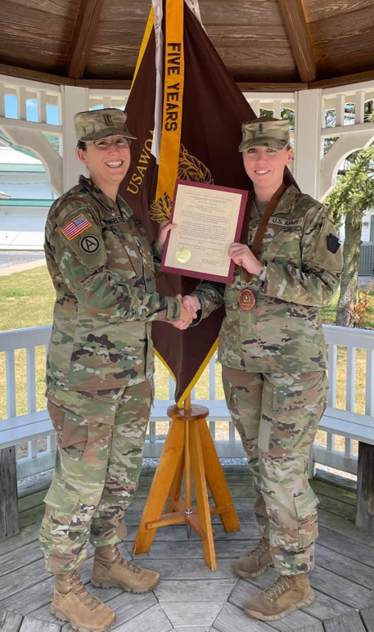
Keystone Silver Chapter HOER presentations

Slide 10
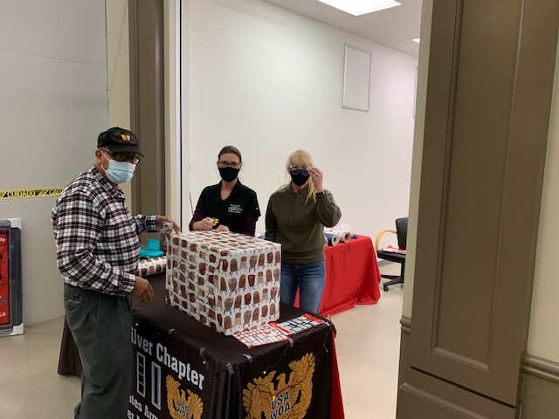
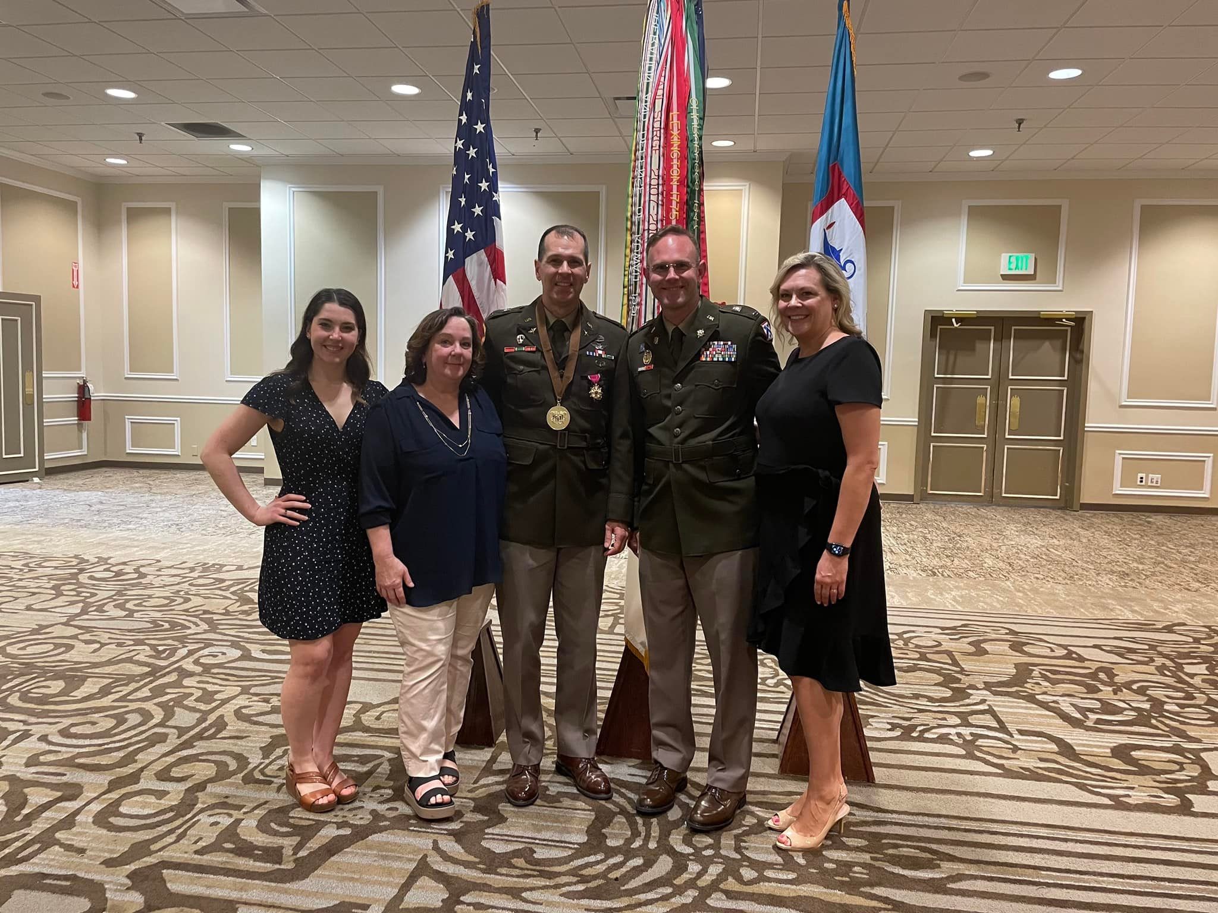
Lord Fairfax Silver Chapter

Slide 11
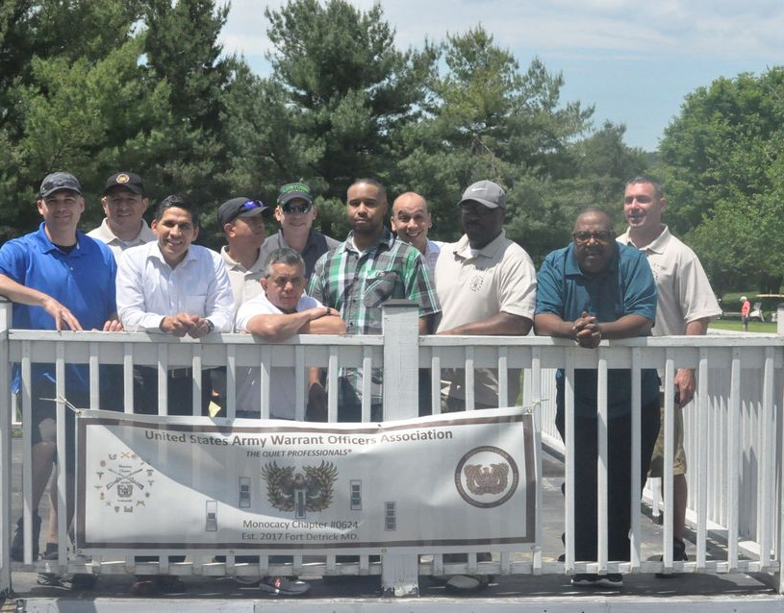
USAWOA Monocacy Chapter Fort Detrick, MD

Slide 12
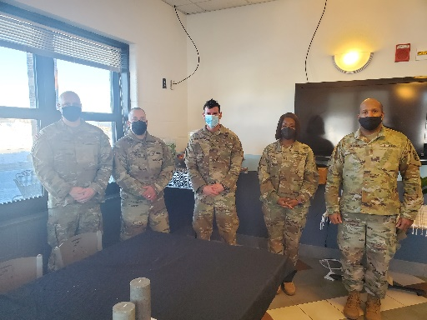
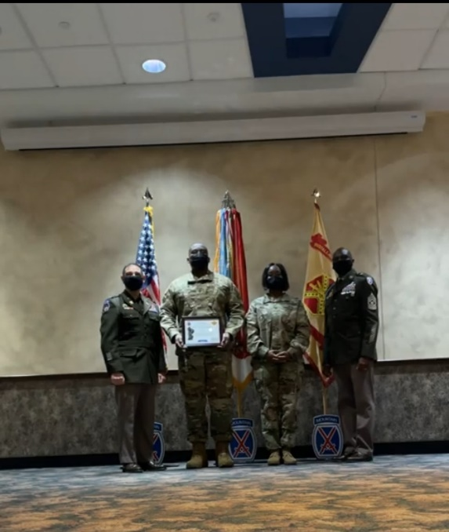
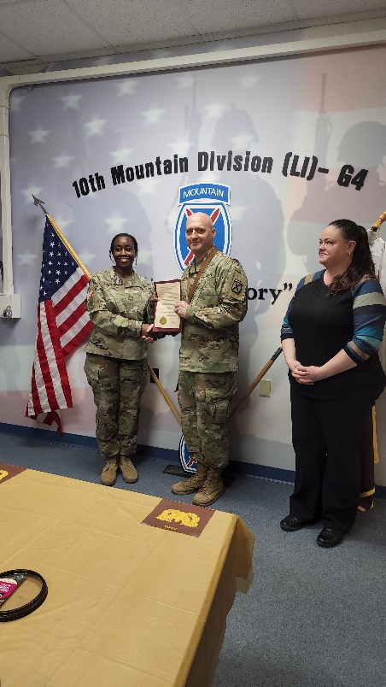
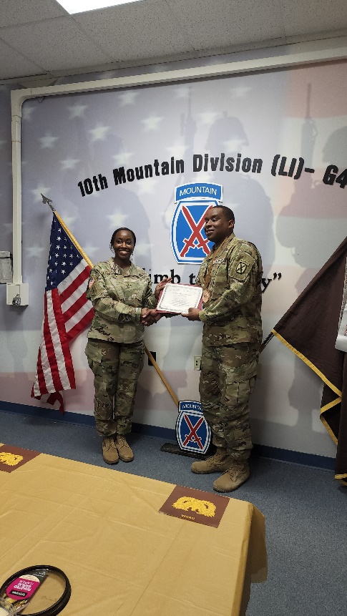
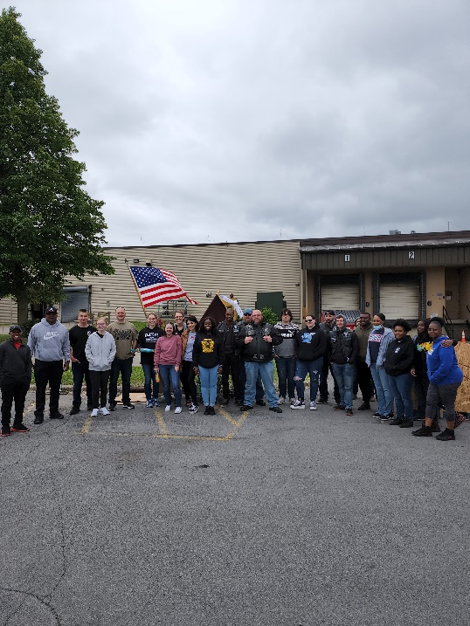
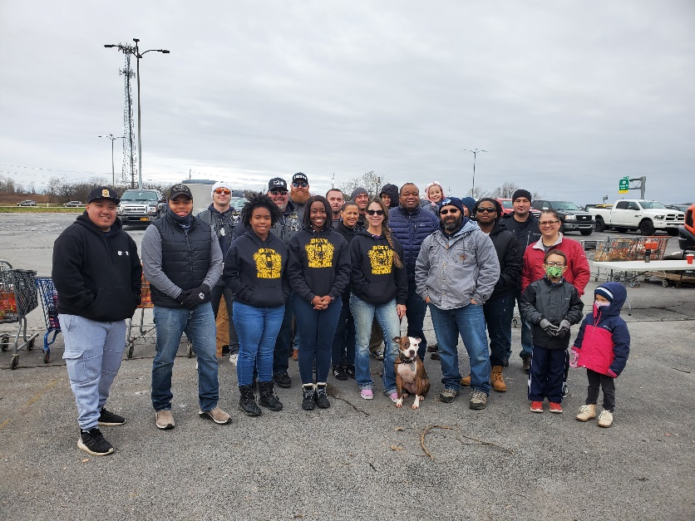
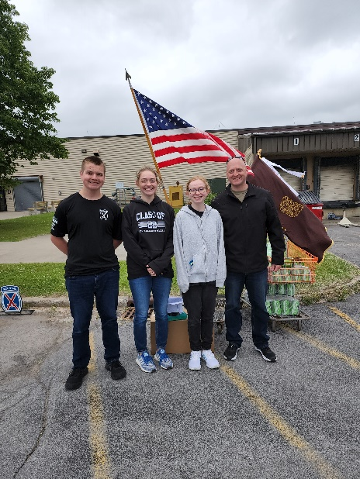
January WOPD
Thousand Islands Chapter
CW2 Tipton Presented Bronze HOER
CW2 Smith Presented Bronze HOER
Feed our Vets of Watertown June 22
Feed our Vets of Watertown June 22
Tipton Family at Feed the Vets Event

